Slide 1
Cubic style Architecture
By: Nathan Luck

Slide 2
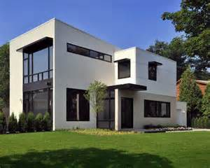
Cubic Style Architecture
This style was created by architect Piet Blom in the 1970s.
The cubic form is often outlined with stacks of larger blocks at the corners.
Doors and windows typically are topped with elaborately-carved decorative lintels.
They are made up of concrete floors, concrete pillars and wooden framing.

Slide 3
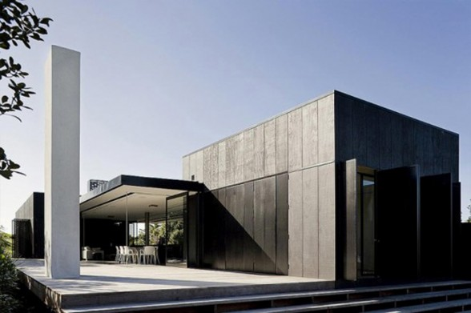
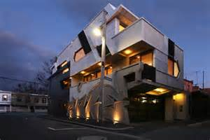
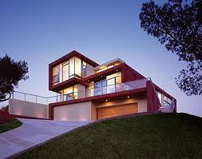
Concrete walls
decorative lintels

Slide 4
References
http://all-that-is-interesting.com/post/12019835848/the-curious-cubic-houses-of-rotterdam

